Slide 1
Formula 1

Slide 2
Project Statement
This project aims to provide a data analysis solution for Formula-1 race results using Azure Databricks. This is an ETL pipeline to ingest Formula 1 motor racing data transform and load it into our data warehouse for reporting and analysis purposes. The data is sourced from ergast.com, a website dedicated to Formula 1 statistics and is stored in Azure Datalake Gen2 storage. Data transformation and analysis were performed using Azure Databricks.

Slide 3
Project Overview
This project leverages Azure Databricks and Azure Data Factory to construct an end-to-end ETL pipeline for analyzing Formula-1 race results. Data from ergast.com, a primary source for Formula 1 statistics, is stored in Azure Datalake Gen2 storage, forming the foundation for the analysis.
Azure Databricks handles the critical tasks of data transformation and analysis, enabling insightful reporting and exploration of Formula 1 data.
Through Azure Data Factory's orchestration capabilities, the pipeline seamlessly manages the flow of data, ensuring efficiency and reliability in the entire process.

Slide 4
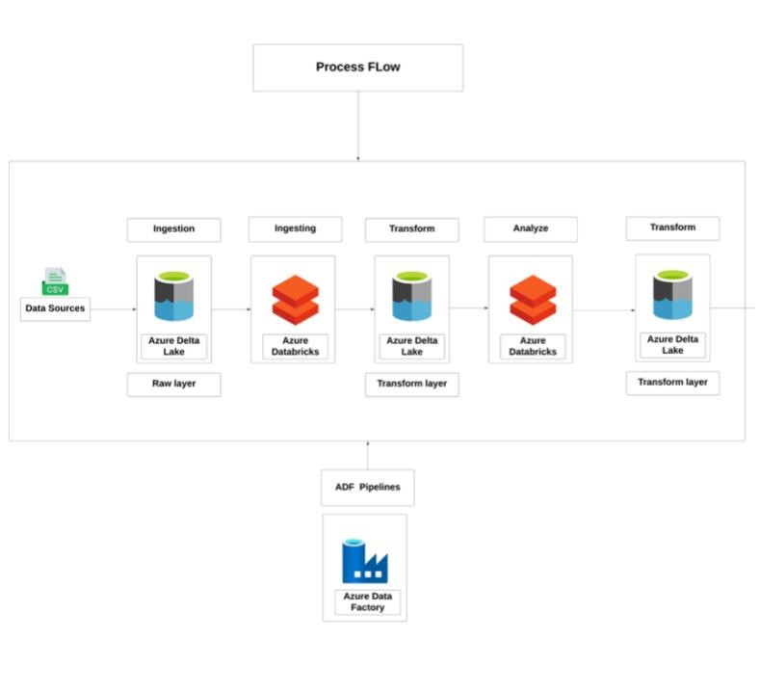
Process Flow

Slide 5
Azure Resources used
Azure Storage account
Azure Data Lake
Azure Data Factory
Azure Databricks

Slide 6
Project Requirements
Get the data from ergast.com
Create a pipeline for copy activity
Ingest the data into azure data lake gen 2
Create databricks notebook and a cluster
Transform the data
Perform analysis

Slide 7
Implementation
Firstly, the formula 1data has been generated from ergast.com
Now this data is ingested into azure data lake gen 2 by performing a copy activity using azure data factory.
For this we need to create a pipeline in data factory.
Configure all the settings required for copy activity.
Now trigger the pipeline
Then the data gets copied successfully

Slide 8
Now create an azure databricks workspace
After that create a cluster in databricks workspace
Create a new notebook
Write code to create a connection between azure data lake and databricks
Load all the data into dataframe
Perform data cleaning and transformation techniques
Data Analysis
Use spark SQL to write codes for analysis of data

Slide 9
Technologies used:
Pyspark
Spark SQL
Azure Data Lake Gen 2
Azure Data Factory
Azure Databricks
Visualization

Slide 10
Thank you

